Slide 1

NBA Players’ Salaries Prediction
CS555
Yuxiao Wu

Slide 2

Business Understanding
Problem
Approach
NBA is one of the most popularly debated sports in the world
The discussion on how each players’ social status, performances, team contribution (and etc) were contributing to their salaries has been heatedly discussed.
Players’ salary range also vary a lot
Build a linear regression model to predict players’ salary based on factors that contribute the most to the target variable-salary
Result could be deployed by individual players, NBA teams, business organizations.

Slide 3
Data Understanding
Data Sources
seaon_stats dataset: NBA Players stats since 1950 | Kaggle
NBA player salary dataset(2017-2018): NBA Player Salary Dataset (2017 - 2018) | Kaggle
"season_stats dataset (each players’ performance statistics)
Filtering out only 2017 statistics
Merge two datasets based on attribute “player name”
Final cleaned dataset: 500 rows and 52 columns
Target Variable: Salary

Slide 4
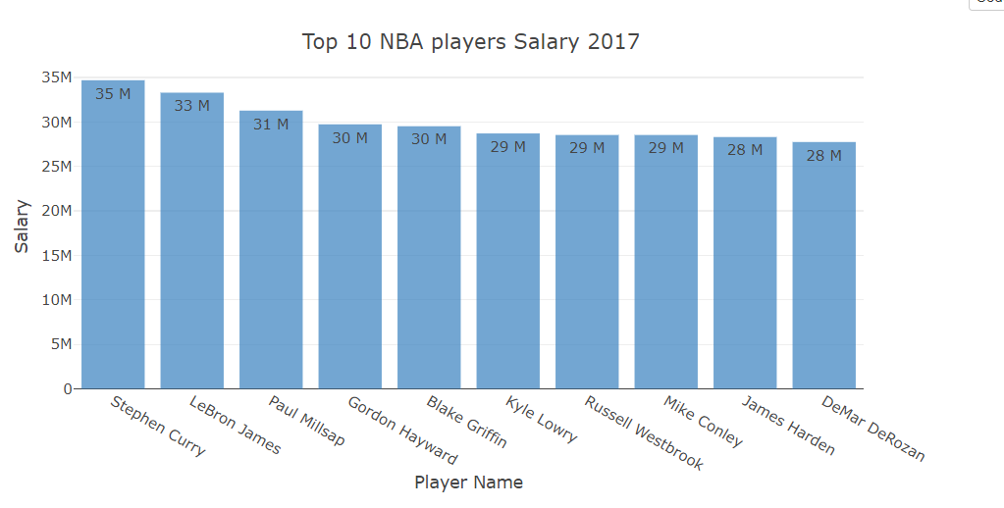
Data Exploration
Highest Paid NBA Players 2017
First, we want to see who is the highest paid NBA player. As shown in the bar chart below, where x axis is Player name and y axis is the Salary, Stephen Curry receives the highest salary which is 35 million, followed by LeBron James, Paul Millsan…

Slide 5
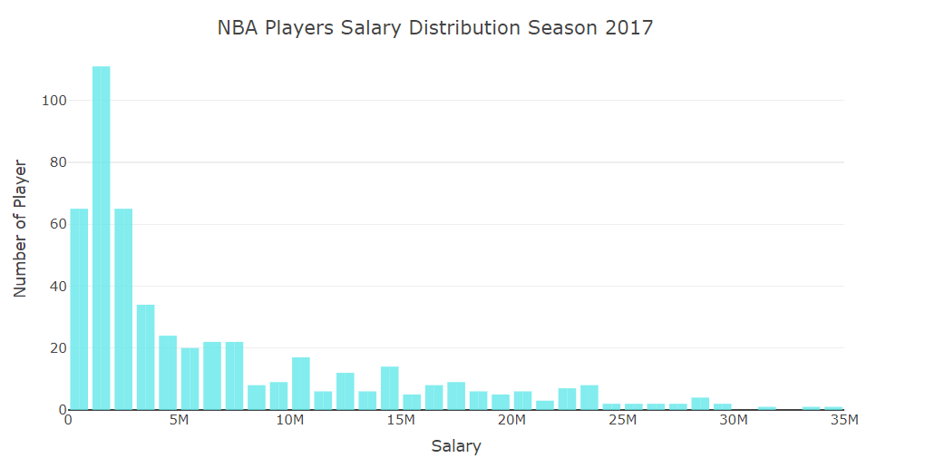
Data exploration
NBA Players Salary Distribution
Among all 509 players in the data set, an histogram plot for their salary was shown below. We can see that the distribution is skewed to the right, which is because there are many NBA stars having very high salary.

Slide 6
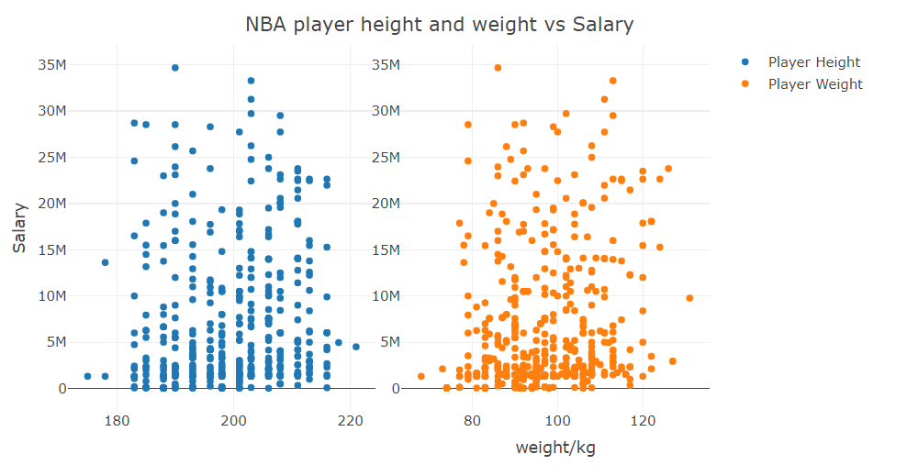
Data exploration
Height and Weight VS. Salary
height/cm
As shown in the scatter plots below, we can see that there is no obvious linear relationship between player’s weight or height and their salary. Correlation between height/weight and salary are also calculated below, and we can see both of them are very low, which means player’s height and weight is not a significant predictor for salary.

Slide 7
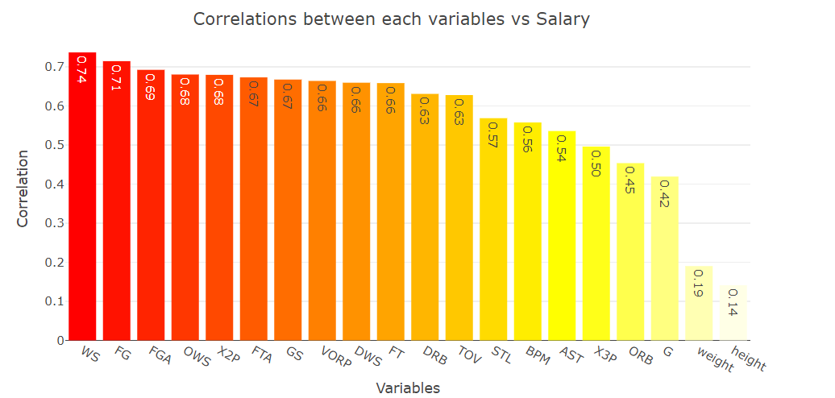
Data exploration
Other Features Correlations
Above is a bar chart plot variables and their correlation with salary. From the plot we can see WS(Win share) has the highest correlation with salary, followed by FG(Field Goal), etc.

Slide 8

Modeling
Modeling Process and Approaches
Simple Linear Regression
Multivariable Linear Regression
Forward and Backward Selection
One-way Analysis of Variance
Pairwise Comparison

Slide 9
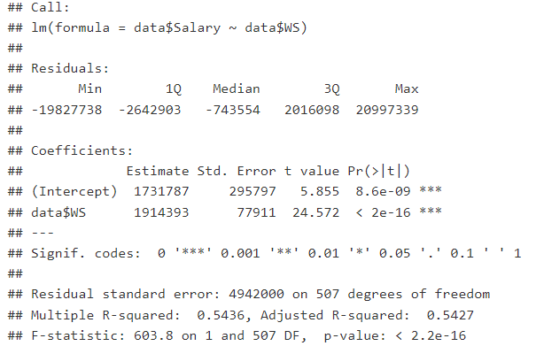
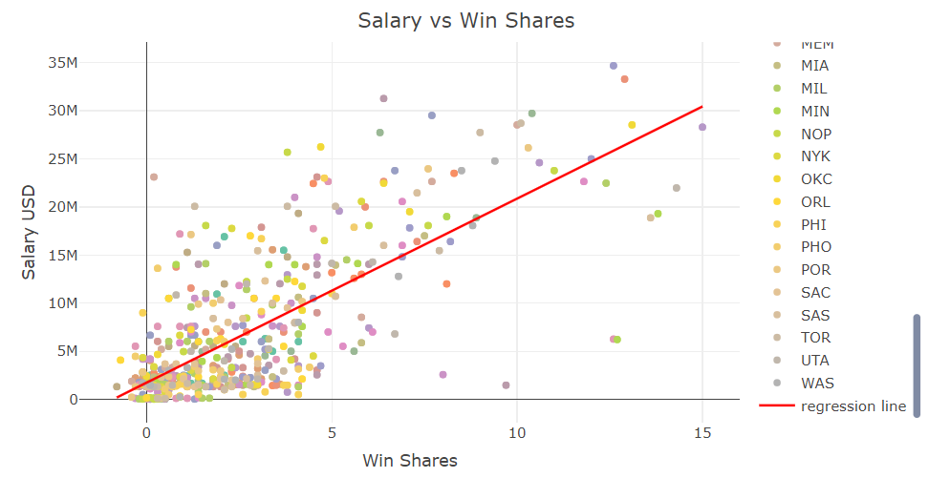
Modeling
Simple Linear Regression
Attribute with highest correlation with salary is Win Share, which equals 0.737, which is a measure that is assigned to players based on their offense, defense, and playing time.
Use WS to build a simple linear regression model to predict salary.
The linear equation can be written as y = 1731787 + 1914393x, The R-square for this model is 0.5144.

Slide 10
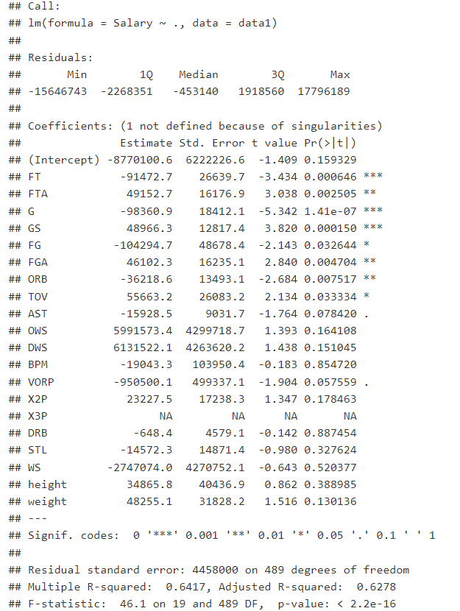
Modeling
Multivariable Linear Regression
Add more variables into the model as independent variables
The multivariate regression model has a R-squared value 0.6417 and adjusted R-squared value 0.628. We add total 19 attributes, while some of them are insignificant such as height and weight.
Next, I decide to use forward and backward selection to choose the best variable to add.

Slide 11
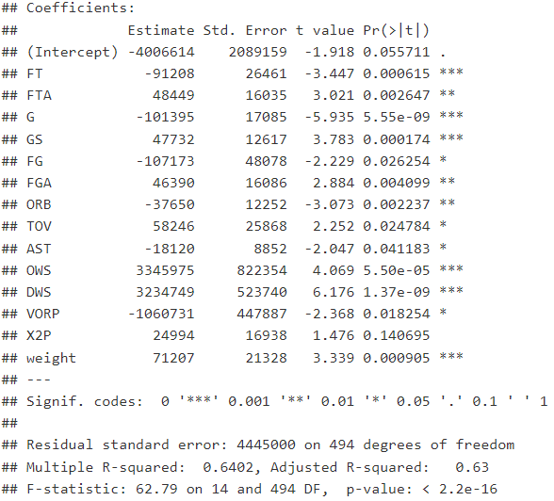
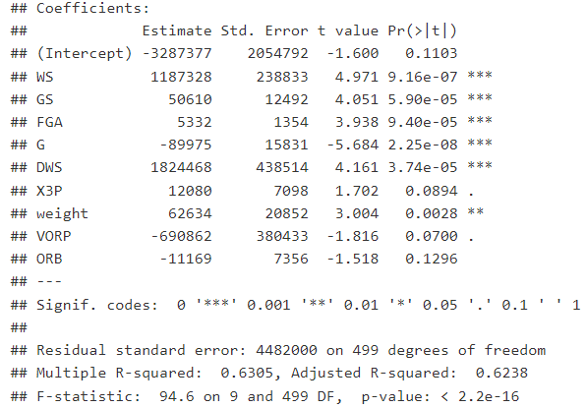
Modeling
Backward Selection Forward Selection
5 variables was removed and 14 are selected.
R-square is equal to 0.6402 and adjusted R-square is 0.63.
9 variables were included, 10 variables was removed.
R-squared is 0.6305 and R-squared value is 0.6238.

Slide 12
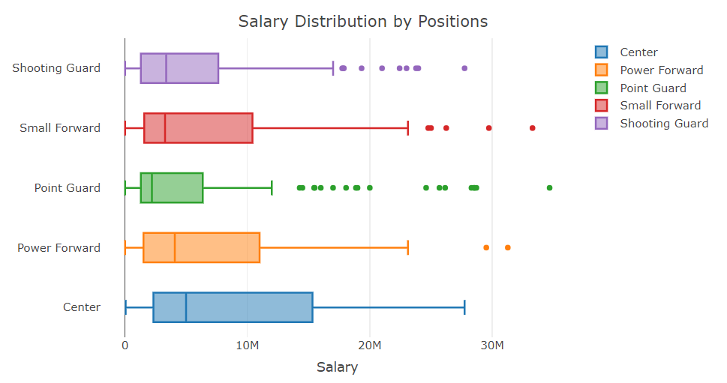
Modeling
One-way Analysis of Variance
*use one way ANOVA to test whether there is a difference between each positions

Slide 13
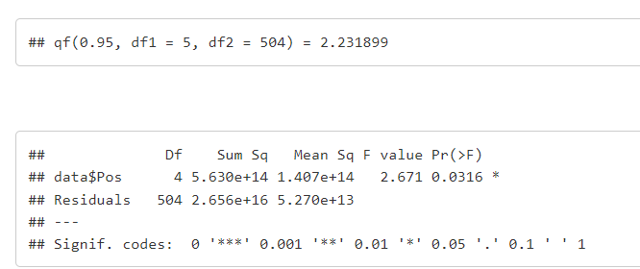
Modeling
One-way Analysis of Variance
Reject H0 if F is greater than 2.232, otherwise, do not reject H0.
By using the aov and summary function, we get the F test statistic value to be 2.671, which is greater than 2.232. Therefore, we will reject null hypotheses. Which means we have significant evidence at α = 0.05 that there is a difference in Salary among different positions including Center, Power Forward, Point Guard, Small Forward and Shooting Guard.

Slide 14
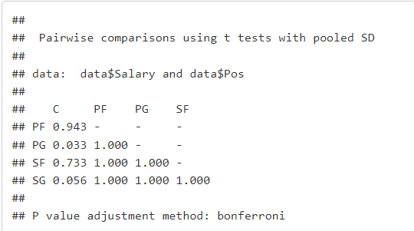
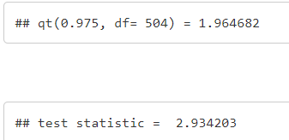
Modeling
Pairwise Comparison
From the pairwise comparisons result we can see that all values are high except two pairs which are C - PG and C - SG. So an additional t test was performed to test whether the mean salary for Center and Point Guard are different at α = 0.05 level.
Since t is greater than 1.96, we will reject H0, which means there is significant evidence that the true salary mean is different for Point Guard and Center at α = 0.05 level.

Slide 15

Conclusion
In conclusion, by using multivariate linear regression, a model was built to predict NBA players salary.
Some significant predictors include Win Share, Field Goals, Games played, Games started, Total Points, etc..
Then the salary among different positions were compared, we found there is at least one pair of mean salary different from each other by using globe f test, and then pairwise t test was used to find out which two group has different mean salary.

Slide 16

Thank You!

